Slide 1


Data Challenge
Kais Kharrat
Adam Saoud
Guillaume Vindry
David Sergio Arrustico Villanueva

Slide 2
Executive Summary
A 5-day data challenge utilizing satellite imagery (Sentinel-2), NDVI, and UNet models to predict crop types, offering insurers a SaaS solution for fraud prevention, faster claims, and better risk assessment.
5-Day Data Challenge: Analyzed time-series satellite images to predict crop types and parcel
Data Cleaning using NDVI: Cleaned and normalized satellite data for consistent analysis using the NDVI vegetation index.
UNet Model : Used UNet for precise segmentation and classification of agricultural parcels.
Business Solution : SaaS tool automating fraud detection, speeding claims, improving risk assessment, and providing ongoing client support.

Slide 3
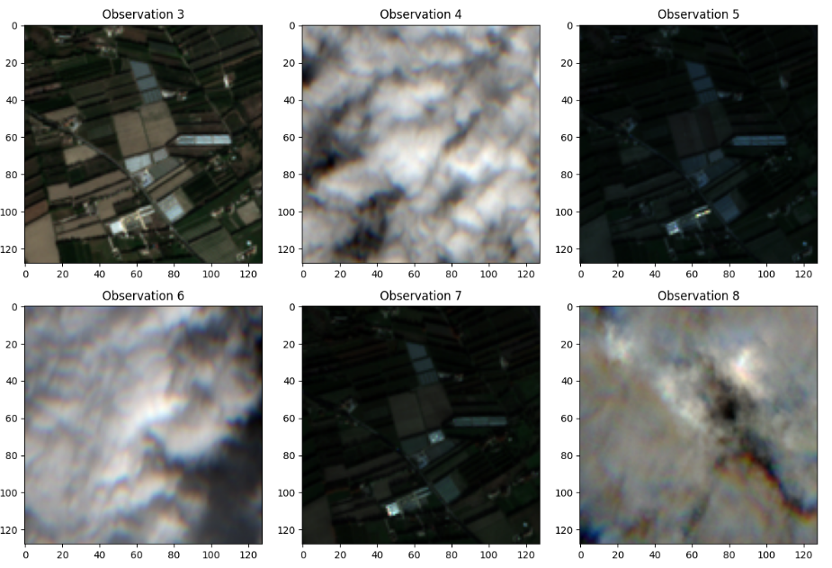
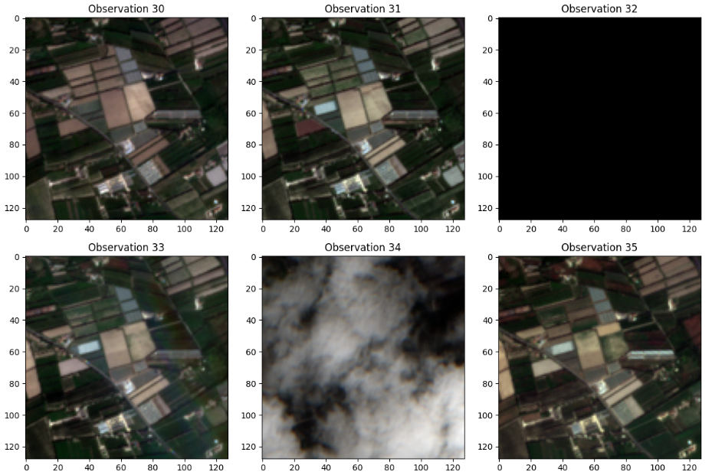
Data quality issues
2 main types of problems
Completely black images
No relevant information
Cloud images
Disturbance of visual image quality
Make image segmentation difficult

Slide 4
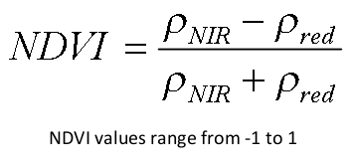
NDVI (Normalized Difference Vegetation Index)
An index widely used to measure vegetation health from satellite images
-Higher Values indicate healthier and denser vegetation
-Lower values indicate less dense vegetation or bare ground
⇒ Delete images whose mean NDVI is below a threshold

Slide 5
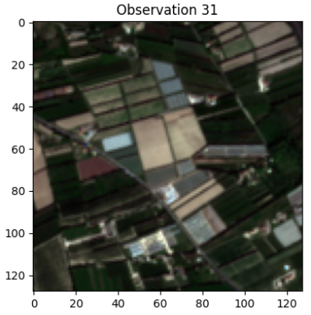
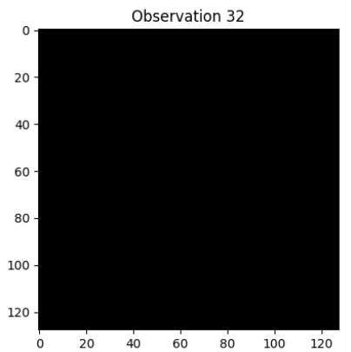
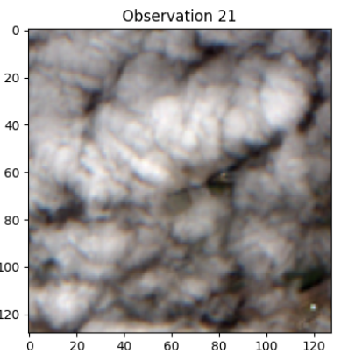
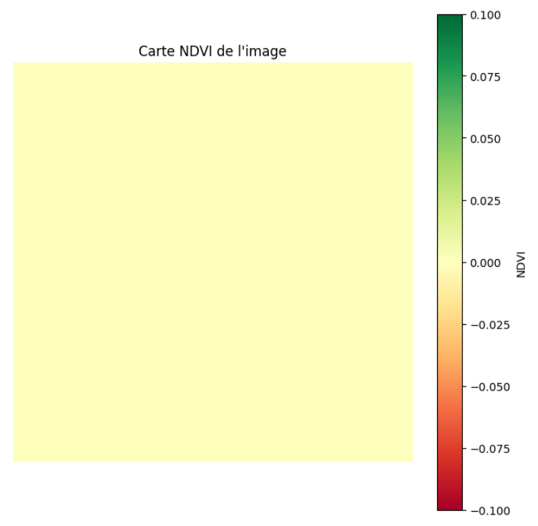
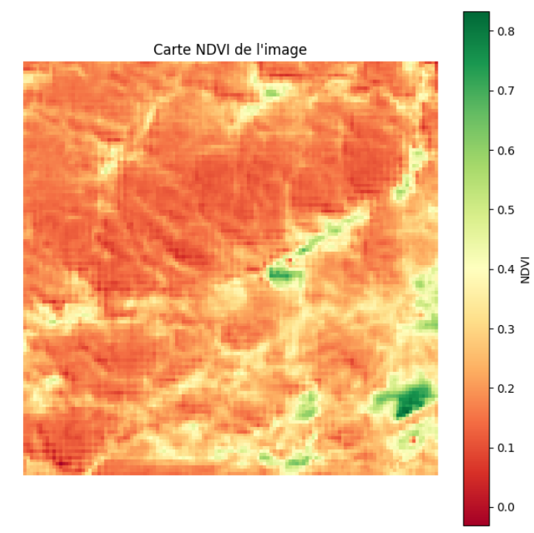
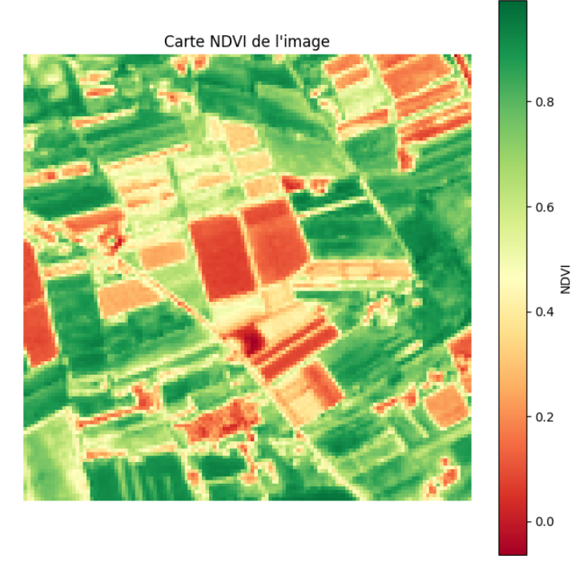
NDVI (Normalized Difference Vegetation Index)
Image with clearly visible vegetation
Black image
Cloud image
Average NDVI = 0.6
Average NDVI = 0
Average NDVI = 0.226

Slide 6
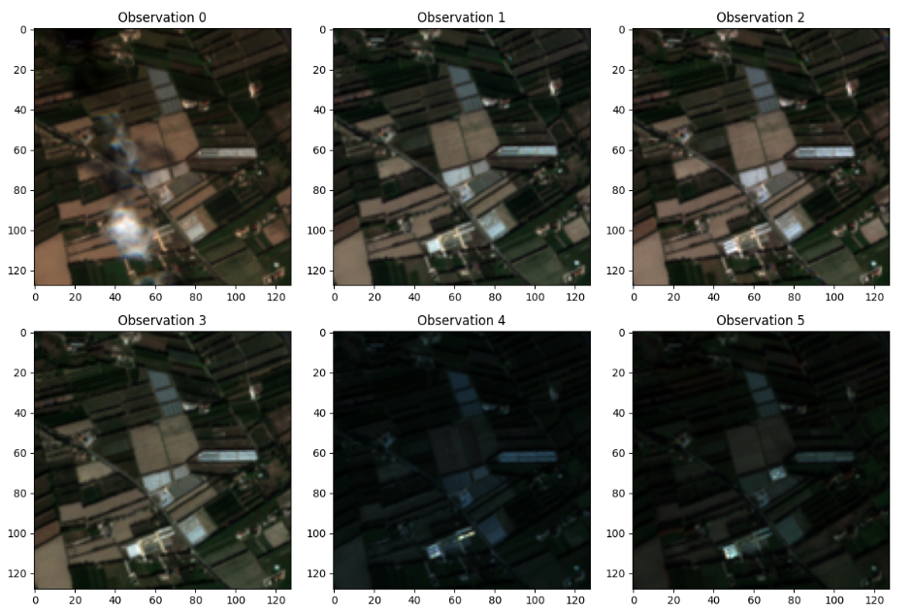
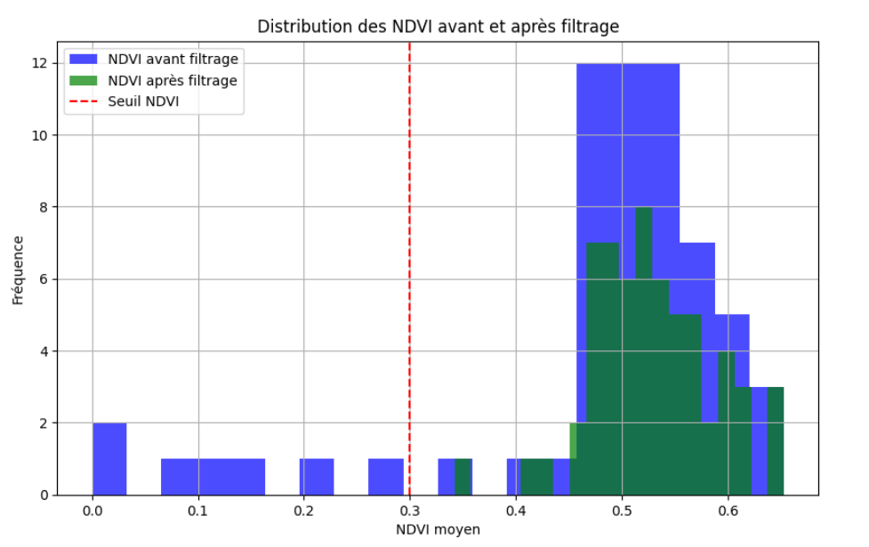
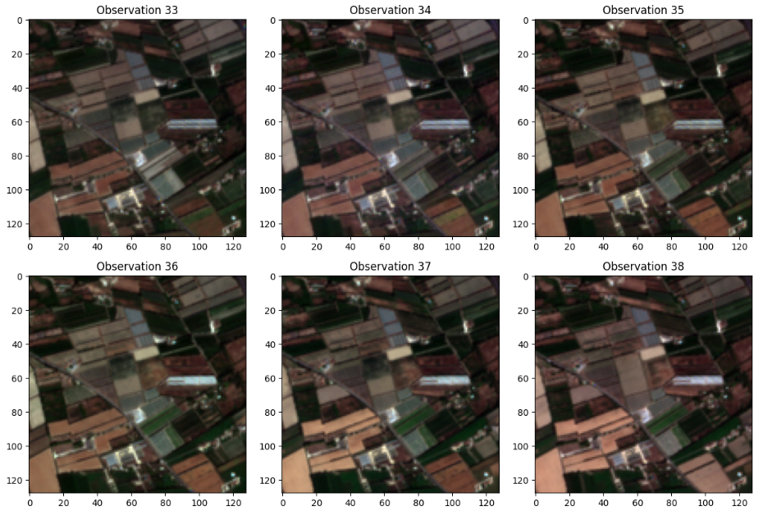
NDVI Cleaning Impact: Enhanced Data Quality

Slide 7
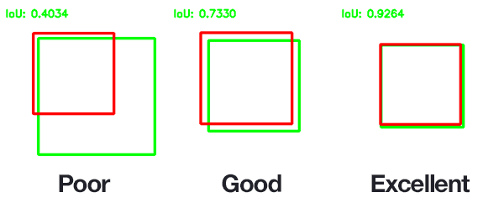
Data Modelling : pretrained models
We need a good semantic segmentation model
Our metric : IoU (measures the overlap between prediction and real surfaces).
First idea : existing pretrained models :
Problem : most pretrained models are RGB, thus the shape must be changed, we lose a lot of the benefit of pretraining.
YOLO-seg : good segmentation model, but needs to be fine-tuned with a special masking format : we would need to reprocess the entire dataset and store it somewhere.
Other datasets pretrained on satellite images: danger of having been trained on PASTIS thus being biased.

Slide 8
Data Modelling
We train a new model from scratch. 2 architectures are considered:
UNet (CNN) : Classic approach, good enough for many semantic segmentation tasks.
Vision transformers : More powerful in theory, but need more data and more training time.
We thought transformers might be useful to capture evolutions in the time dimension.
Data preprocessing:
Augmentation : Rotating the images.
Preprocessing : removing the cloudy images with a threshold on the NDVI.

Slide 9

Data Modelling
UNet : Encoder - decoder structure with skip connections.
Reduces the dimension of the image by convolution to extract the crop categories.
Implementation from : https://github.com/milesial/Pytorch-UNet
The priority was to have a good enough spatial segmentation, with the time evolution as an additional information.
Thus we reduce the time series by taking their median. Empirically, it works better than taking the average.
Training : around 30 epochs gave the best results, then it starts to overfit, even with augmentation.

Slide 10
Further Work
Ideas for improvement:
Training a 4D CNN on the time series to take into account evolution of the crops, which may give us insight into the type of plants, which may grow at different speeds and times of the year
Using NDVI as an additional channel.
Other data augmentation techniques like changing the contrast, adding noise or removing some areas.

Slide 11
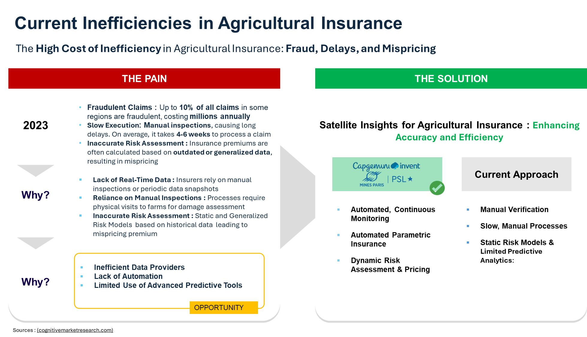

Slide 12
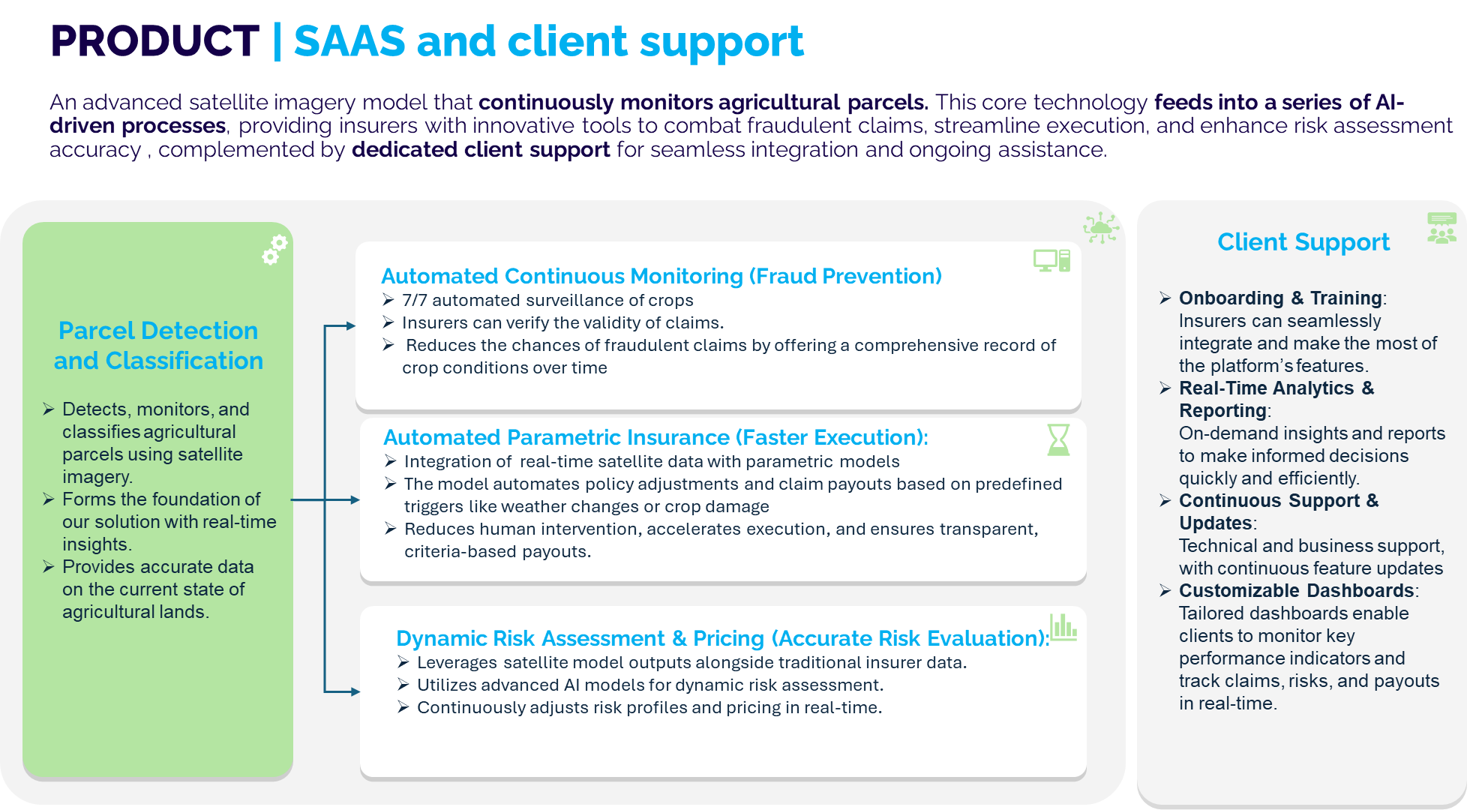

Slide 13
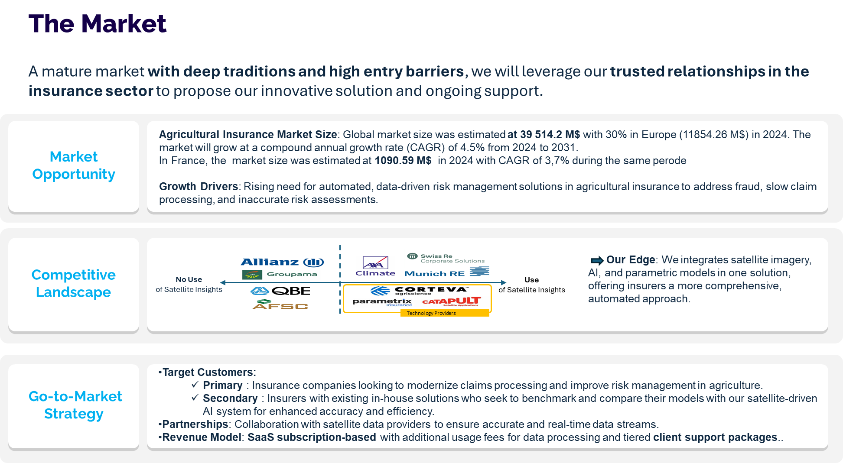

Slide 14
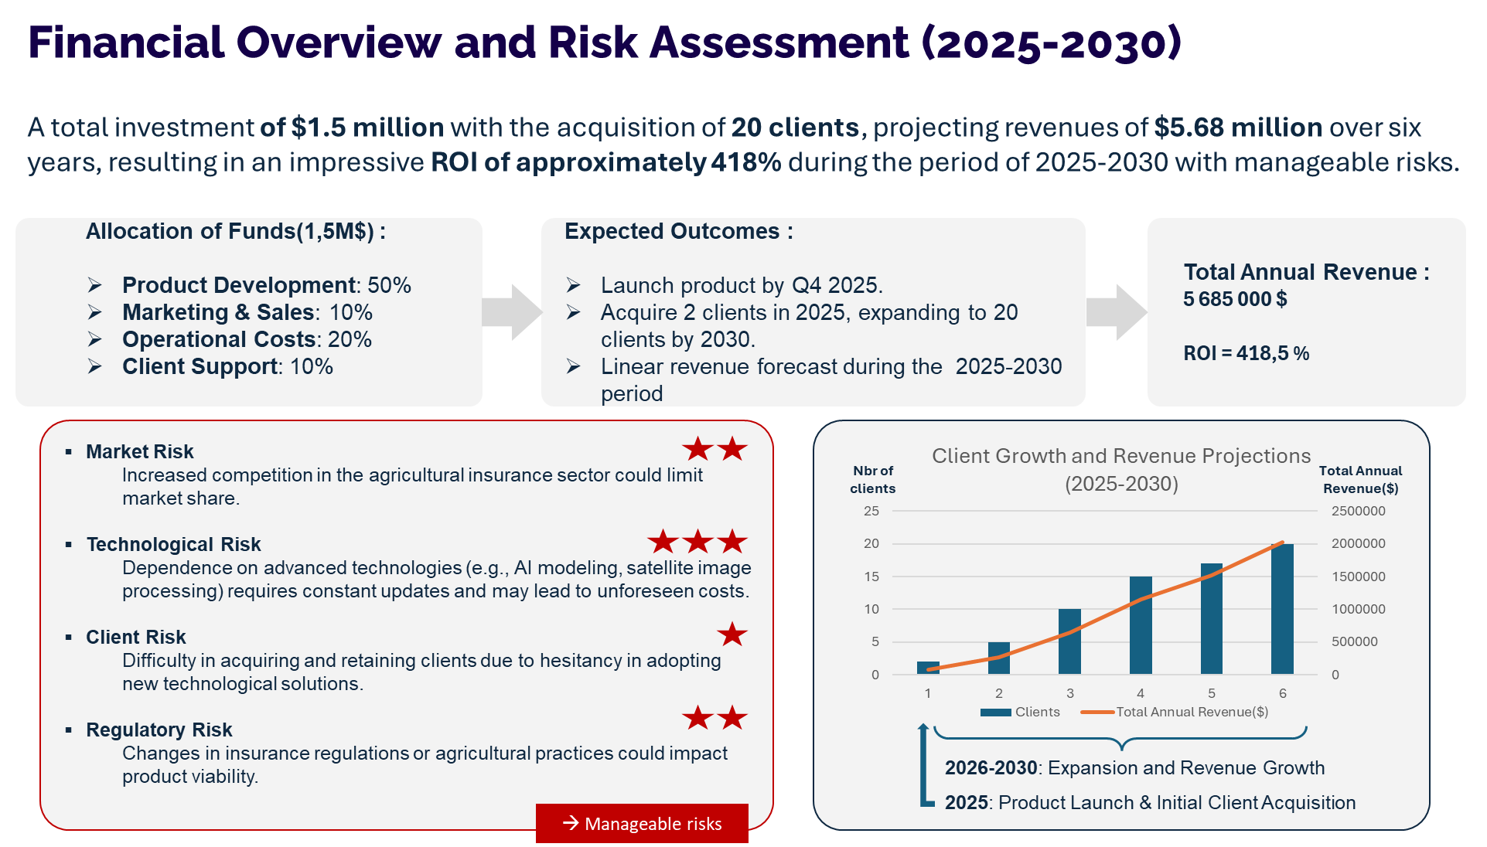

Slide 15
Data Challenge
Kais Kharrat
Adam Saoud
Guillaume Vindry
David Sergio Arrustico Villanueva

Slide 16
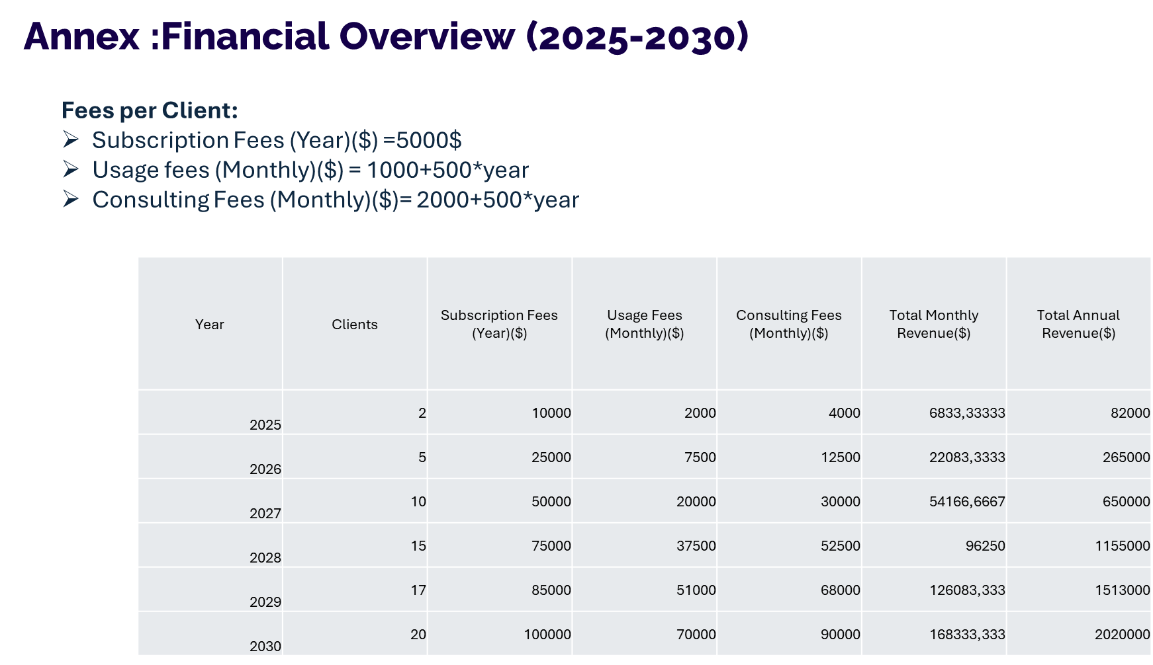

Slide 17
Papers
[1] 4D U-Nets for Multi-Temporal Remote Sensing Data Classification (Giannopoulos et al. 2022)

